Slide 1
The Role of Nurse as Knowledge worker
Presenter:

Slide 2

Review of Informatics Concepts
Nursing informatics centers on concepts of data, knowledge, …
It is a specialty which integrates information technology in …
It is meant to show the importance of keeping patient related data safe
It serves as evidence to refute any legal questions related to …
Notes:
The concepts of nursing informatics continues to find utility in the healthcare setting. The concept is centered on data, information, knowledge and wisdom which not all healthcare providers may have. It is in most cases a …,

Slide 3
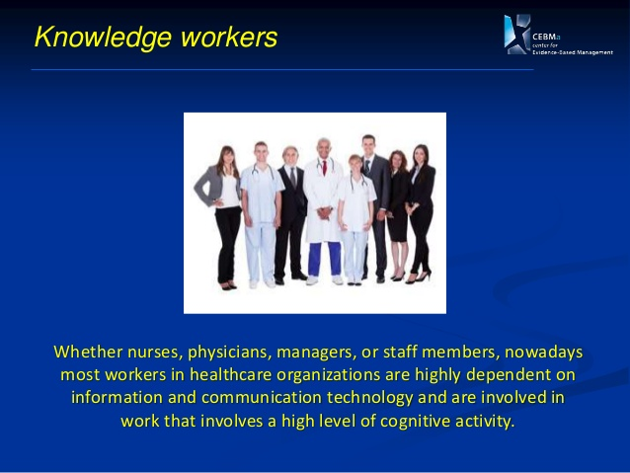
Concept of a Knowledge worker
Knowledge workers generate information …
Knowledge workers are supposed to respond to …
They capture, assess, apply and finally disseminate knowledge based on the needs at hand
They also need to be equipped with necessary …
Notes:
Knowledge workers in any work environment have a great role to play as they are supposed to be specialists in their areas of expertise. In case of any emerging situation, they have to use their skills and knowledge to ensure timely response. In some settings, they …

Slide 4
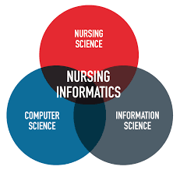
Explanation of Nursing Informatics
Nursing informatics is a subspecialty of Health Informatics
It is also …
It relies on point of care data in improving care and patient outcomes
As shown in the Infographic, it is built on …
Notes:
Nursing informatics is meant to assist in the management as well as processing of nursing …

Slide 5
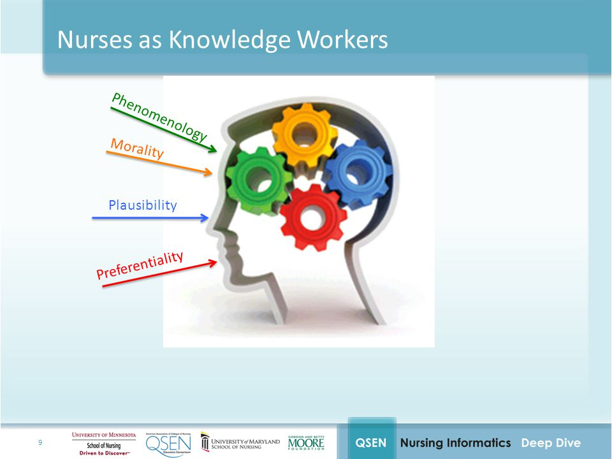
Role of a Nurse Leader as a knowledge worker
They gather data to be used in …
They help advocate for ethical practices …
They are supposed to interpret collected data
They evaluate possible trends from the data …
Notes:
As knowledge workers, nurses have a great role to play. First, they ensure …

Slide 6
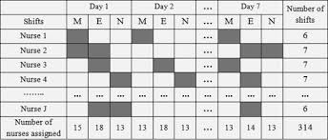
The hypothetical scenario
Assigning nurses in different shifts can generate a lot of data
It needs a clear consideration of the workload
It must also have enough data on the projected population of patients
There is also need to cater for eventualities and hence the need to have an overlap in the number of patients
Notes:
The hypothetical scenario that can result in generation or use of data is on …

Slide 7
Examination of data that could be used
Patient-related data can be retrieved from an electronic health record system
The allocation of nurses …
Data should also consider day …
Notes:
The data to be used in the case scenario include patient related which can be …

Slide 8

How the data could be accessed
From electronic health record system
From previous nursing role allocation charts
Data can also be obtained from previous experiences in the facility
Notes:
Data is necessary in making the clinical decision in this setting. Firstly, electronic health record system can inform on the records of patients that have been admitted in the healthcare setting. The previous role allocations and responsibilities can also be used to provide the much needed data. Lastly, data can also be retrieved from previous experiences within the facility.

Slide 9
Knowledge derivable from the data
The data will be able to give:
  Workload of healthcare providers
  The projected number …
  The likely overlap of …
  The number of …
Notes:
The knowledge that the data will give is diverse. First and foremost, it will indicate how many workers are away as compared to those supposed to be in the facility at a time. Patient data will also inform on how many …

Slide 10
References
McGonigle, D., & Mastrian, K. G. (2017). Nursing informatics and the foundation of knowledge (4th ed.). Burlington, MA: Jones & Bartlett Learning.
Nagle, L., Sermeus, W., & Junger, A. (2017). Evolving role of the nursing informatics specialist. In J. Murphy, W. Goossen, & P. Weber (Eds.), Forecasting Competencies for Nurses in the Future of Connected Health (212–221). Clifton, VA: IMIA and IOS Press. Retrieved from https://serval.unil.ch/resource/serval:BIB_4A0FEA56B8CB.P001/REF
Yen, P. Y., Phillips, A., Kennedy, M. K., & Collins, S. (2017). Nursing informatics competency assessment for the nurse leader: instrument refinement, validation, and psychometric analysis. JONA: The Journal of Nursing Administration, 47(5), 271-277.

