Slide 1
Knowledge Worker
Name
Institution

Slide 2
The Concept of a Knowledge Worker
Definition of a knowledge worker by Peter Drucker
Professionals that are referred to as knowledge worker
Notes:
The term “knowledge worker” was first coined by Peter Drucker. Ducker defined knowledge workers as high-level workers who apply theoretical and analytical knowledge, acquired through formal training, to develop products and services (Conrad & Sherrod, 2016). He emphasized that due to the high level of productivity and creativity of knowledge workers, they should be the most valuable assets in the 21st century organization. Professionals that can be referred to as knowledge worker includes nurses, engineers, pharmacists, architects, financial analysts, public accountants, physicians, scientists, design thinkers, and lawyers. Furthermore, knowledge workers have a high degree of expertise, experience, education, and the primary purpose of their jobs involve the distribution, creation, and application of knowledge (Conrad & Sherrod, 2016).

Slide 3

Nursing Informatics
Nursing Informatics is a branch of informatics focusing on nursing specialty and specific roles of the nurse within the healthcare environment.
Different interpretations of nursing informatics exist.
The American Nurses Association (ANA), considers nursing informatics as a field that involves nursing, science, computer science, and information science to effectively communicate and manage data, information, and knowledge in nursing practice

Slide 4
Nurse leader as a knowledge worker.
Definition of a nurse leader
Nurse Leader as a knowledge worker
Organizational outcomes and productivity of a healthcare organization
The use of Evidenced Based Practice (EBP) by a knowledge worker
Notes:
A nurse leader is one who inspire others to work together to achieve a common goal, for instance enhanced patient care or satisfaction. All nurses are called to nurse leadership; however there are different levels of nurse leadership. Nurse leaders are expected to help the organization to fulfill the organization’s mission, vision, values, and strategies to achieve long-range plans (Conrad & Sherrod, 2016). Nurse leaders part take in policy setting, overseeing quality measures are carried out, accountability for overall quality of patient care delivery, staff satisfaction and organizational outcomes. For a nurse leader as a knowledge worker to be productive in an organization, the nurse leader must understand that knowledge work requires continuous learning on the part of the knowledge worker, but equally continuous teaching on the part of the knowledge worker. Having said that, a knowledge worker nurse leader will depend hugely on evidenced based practice to be productive in a healthcare organization. The use of EBP by knowledge worker nurse leader will require learning and teaching. Most healthcare organizations or hospitals rely on evidenced based practice to improve patient care, increase job satisfaction, decrease cost etc. Utilization of EBP can increase job satisfaction thereby decreasing turnover, foster organizational cohesion, improve patient outcomes, and decrease hospital costs (Conrad & Sherrod, 2016).

Slide 5
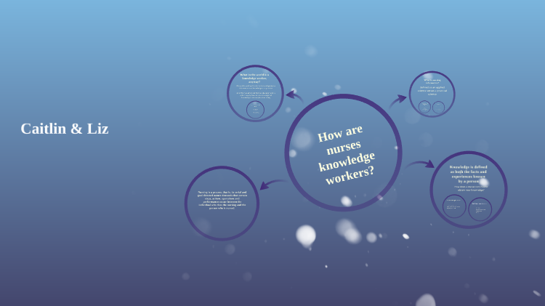

Slide 6
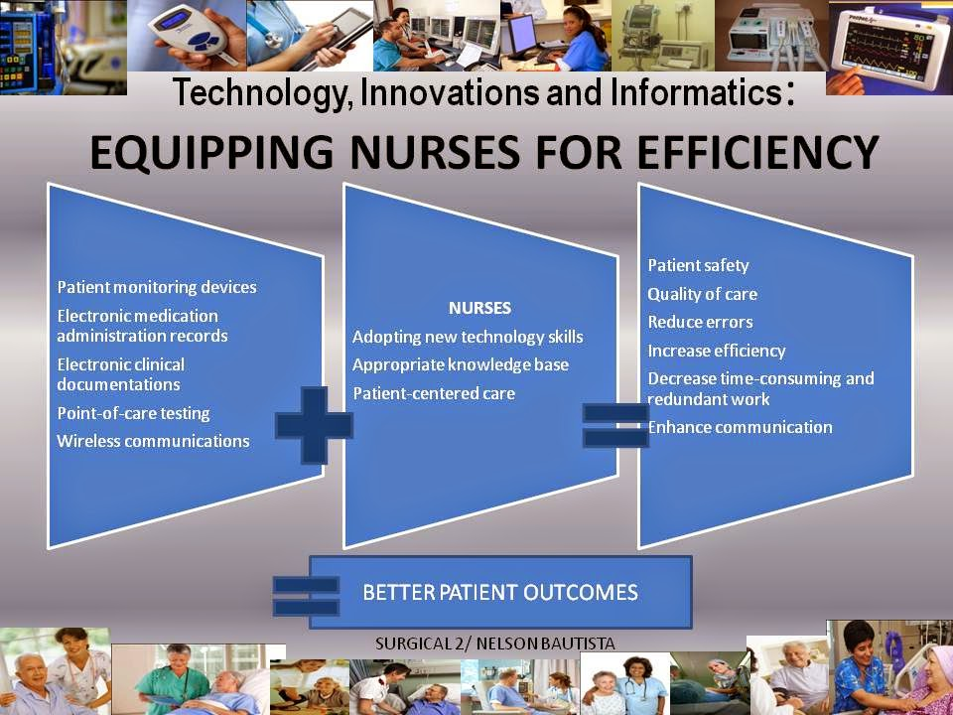
Nursing Informatics’ Scenario
Notes:
Over the last few years, my healthcare organization has integrated and implemented several changes in terms of safety measures to help ensure the overall well-being of every patient. The organization has also shifted from the conventional pen and paper documentation to the modern-age electronic medical records. In the inpatient unit, each patient is provided with a code that helps us monitor and safeguard their rights to medication and all. The code also provides the organization with the opportunity to decrease any possibilities of medication error. While the organization has made huge strides, there are other sections and areas within the hospital that need to be revised, especially for nurses. One day, while using the MUMMS software to collect data a patient diagnosed with diphtheria was discharged with the wrong medications and treatment. This was mainly due to medication reconciliation errors. The organization was notified of the same that's when they discovered that the MUMMS software had some hitches in terms of the orders that had been earlier made. The organization eventually shifted to an EMR system to help collect data on patients and provide medication profiles. Moreover, I believe that the EPIC system could have been used instead to collect, organize and store patient's data more safely.
The continued evolution of nursing informatics around the globe has played a significant role in enhancing patient healthcare and safety. According to McCormick & Saba (2015), nursing informatics is the use of computer and information science to manage and communicate data. With the use of informatics within the healthcare industry, the industry has transformed in entirety into a technological system where data is easily collected to enhance the healthcare experience of the patient. Healthcare practitioners, through nursing informatics, can review the patient's data and work collectively to offer excellent healthcare experience to patients (Yen et al., 2017). Information technology has empowered nurses and other healthcare practitioners to involve significant communication of patients' medical records and information to ensure continued access to different policies and protocols when necessary (Austin, 2018). The use of an integrated system within healthcare enables medical practitioners to address issues as they arise.

Slide 7
References
Austin, R. R. (2018). Precision health and integrative nursing. Integrative Nursing, 128.
McCormick, K., & Saba, V. (2015). Essentials of nursing informatics. McGraw-Hill Education.
Yen, P. Y., Phillips, A., Kennedy, M. K., & Collins, S. (2017). Nursing informatics competency assessment for the nurse leader: instrument refinement, validation, and psychometric analysis. JONA: The Journal of Nursing Administration, 47(5), 271-277.
Conrad, S., & Sherrod, D. (2016). Nurse leaders as knowledge workers. Nursing Management, 42(2), 47-48.

